Slide 1

Seussical Jr Audition Information
Here are the 5 steps to audition for the musical.
You MUST complete all of them to be eligible to audition.

Slide 2
Important Information!
If you make the cast our
First practice and Mandatory Parent meeting
Will be 12/17/2024
3:00-5:00pm practice
5:00 p.m. Mandatory Parent Meeting
Show Dates are Friday, April 25th at 6:30 pm,
and Saturday, April 26th at 2 pm.

Slide 3
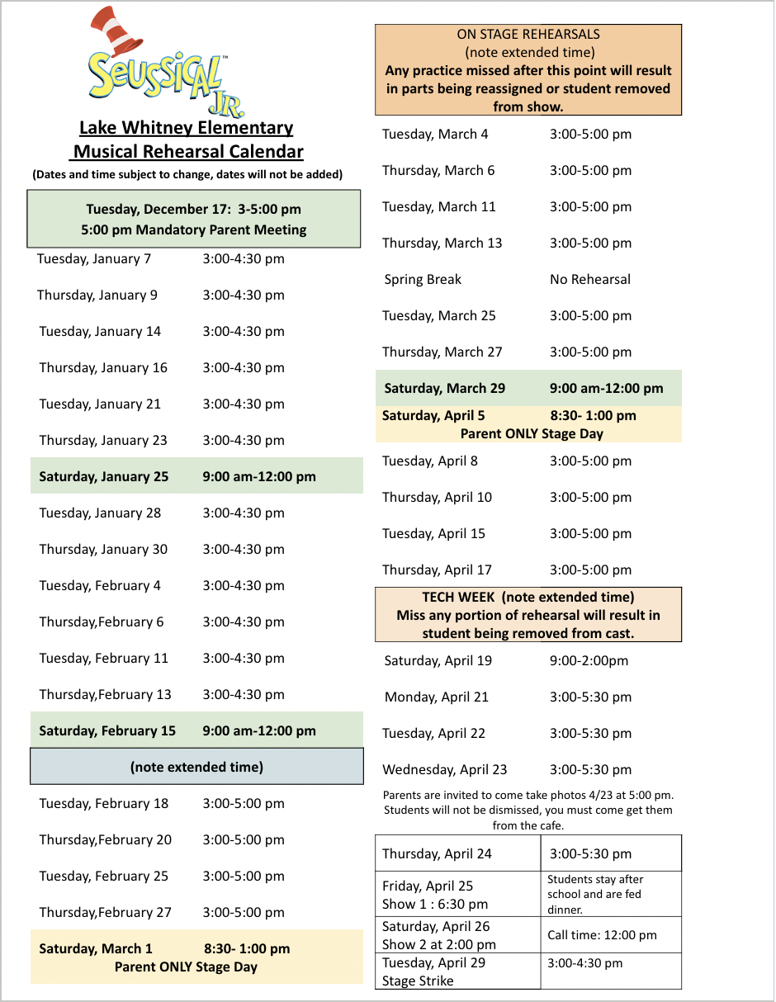

Step 1
Check over the performance and rehearsal dates to ensure you can make the commitment.
Seussical Jr 2025 Rehearsal Calendar
Click on the calendar to download as a PDF

Slide 4
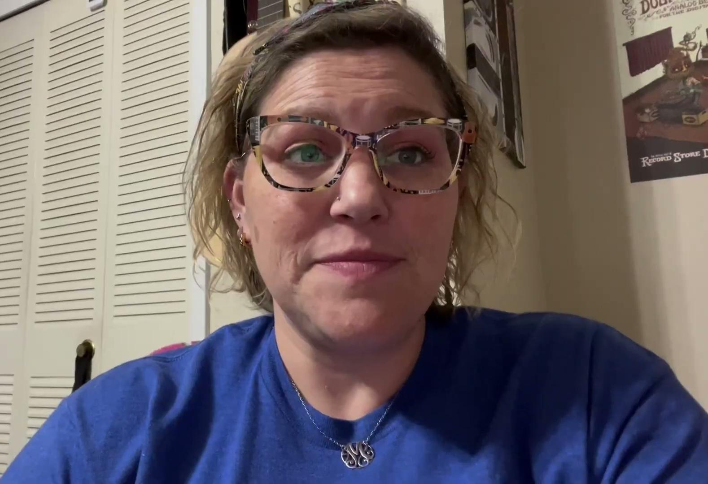
Where do I start?
Step 2
Please watch all the videos and review this information with your grown up.

Slide 5
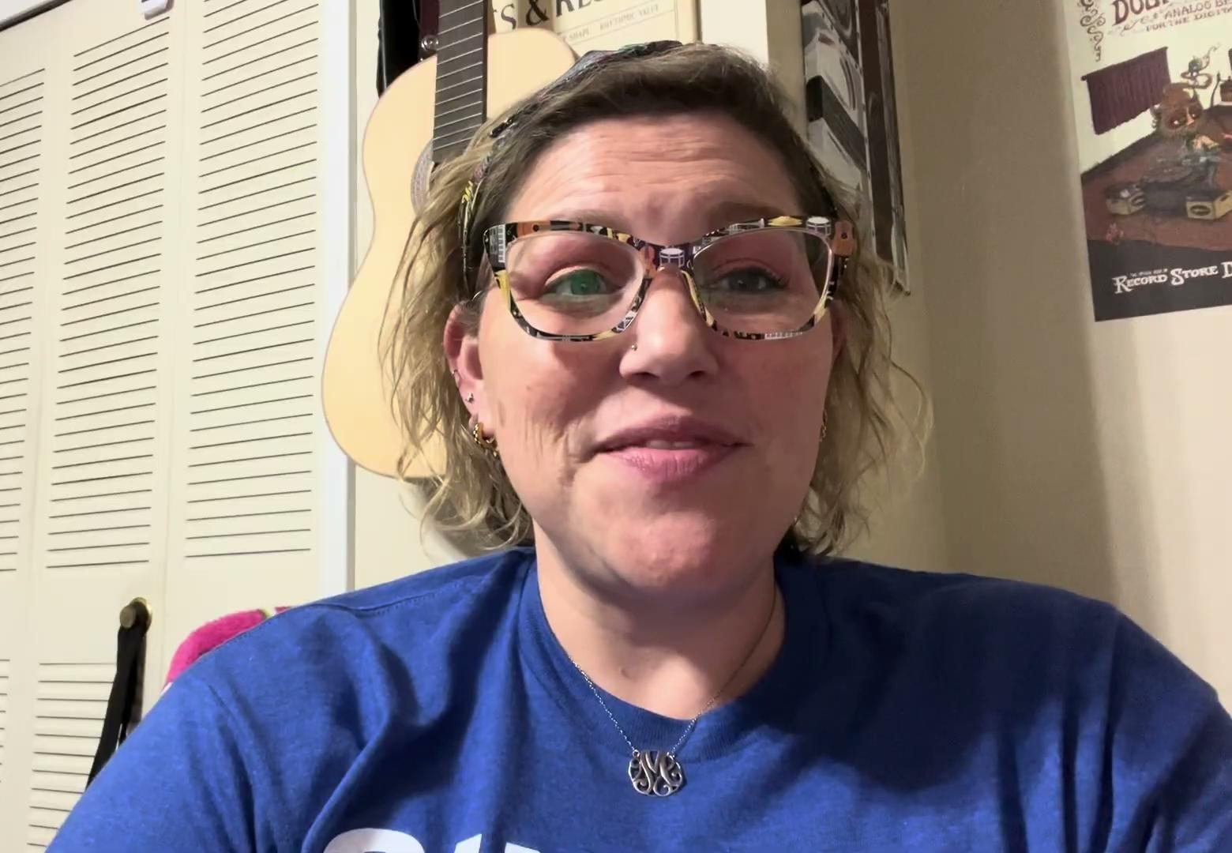
Step 3: What do I need to learn?

Slide 6
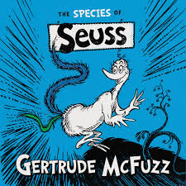
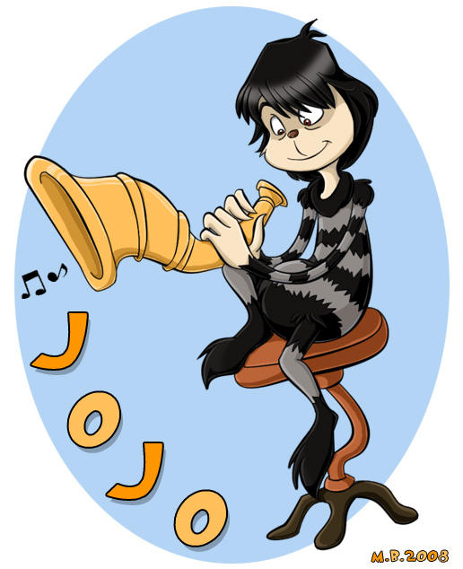
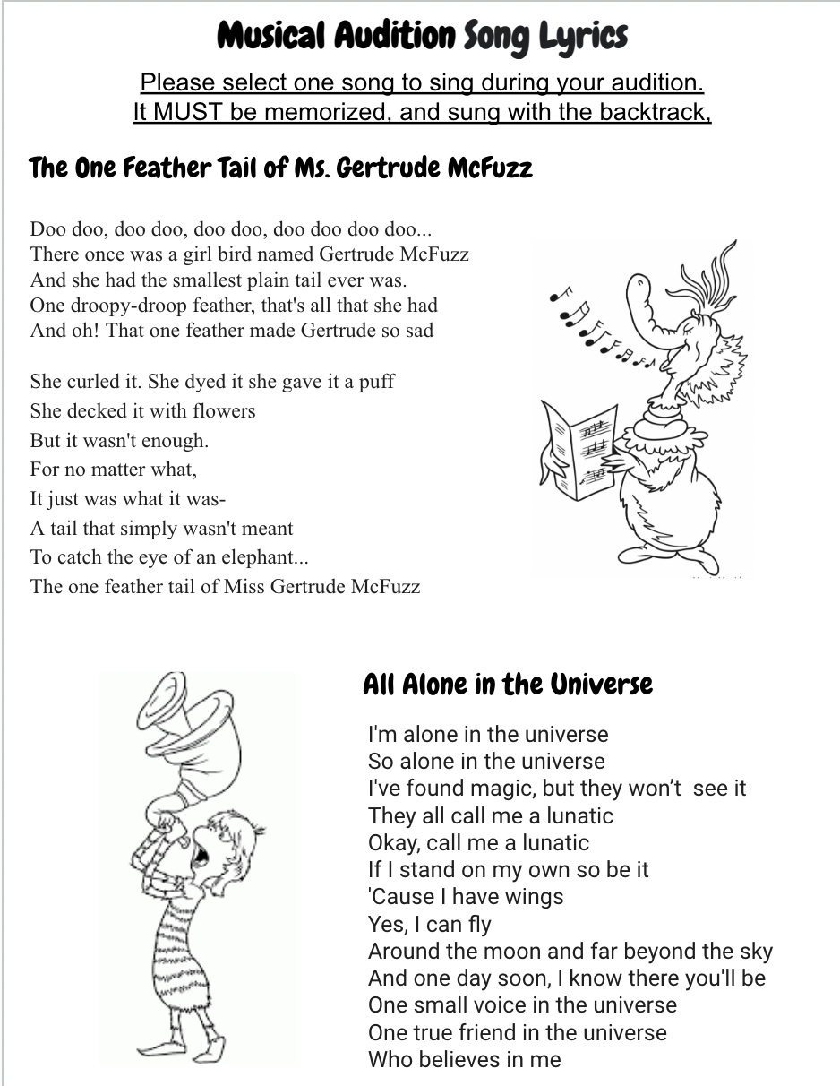
Step 3
For your audition, You MUST learn and memorize one song and one poem
Use the click on the picture below to select your song and poem.
Audition Poems and Lyrics: Click on the link below.
https://drive.google.com/file/d/1cuKM0CkDjUiappyO5q3wePwl64X3kP5R/view?usp=sharing

Slide 7

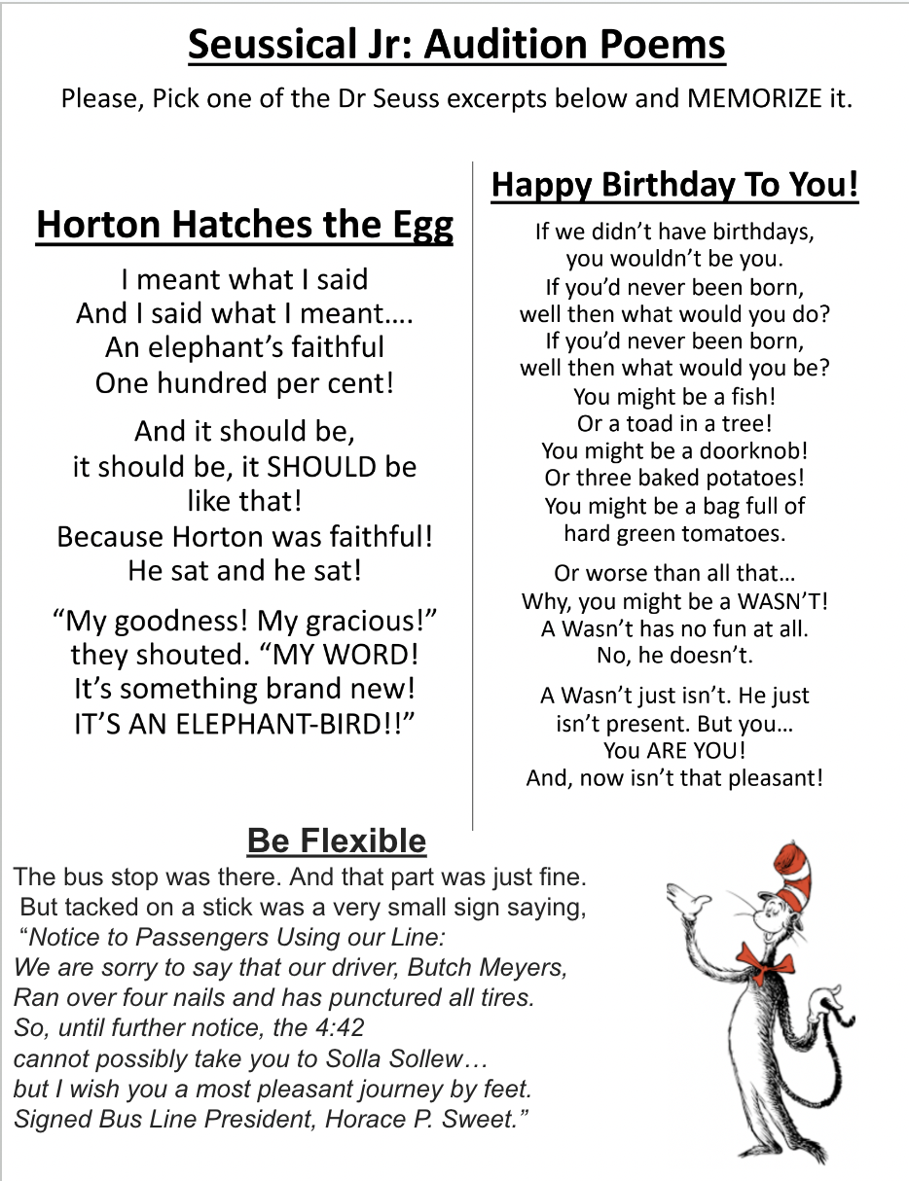
You must select and MEMORIZE one of the pre selected poems below.
Audition Poems and Lyrics: Click on the link below.
https://drive.google.com/file/d/1cuKM0CkDjUiappyO5q3wePwl64X3kP5R/view?usp=sharing

Slide 8

Song Choice 1:
The One Feather Tail of Ms. Gertrude McFuzz
For your audition, You MUST learn and MEMORIZE one of the song
There are two tracks for each piece, One with words and one without words.
You will audition with the backtrack (no words).
The One Feather Tail (with words)
The One Feather Tail
(backtrack, you will use this for your audition)
Audition Poems and Lyrics: Click on the link below.
https://drive.google.com/file/d/1cuKM0CkDjUiappyO5q3wePwl64X3kP5R/view?usp=sharing

Slide 9
Song Choice 2: Alone in the Universe
For your audition, You MUST learn and MEMORIZE one song
There are two tracks for each piece, One with words and one without words.
You will audition with the backtrack (no words).
Alone in the Universe
(with words)
Alone in the Universe
(backtrack, you will use this for your audition)
Audition Poems and Lyrics: Click on the link below.
https://drive.google.com/file/d/1cuKM0CkDjUiappyO5q3wePwl64X3kP5R/view?usp=sharing

Slide 10
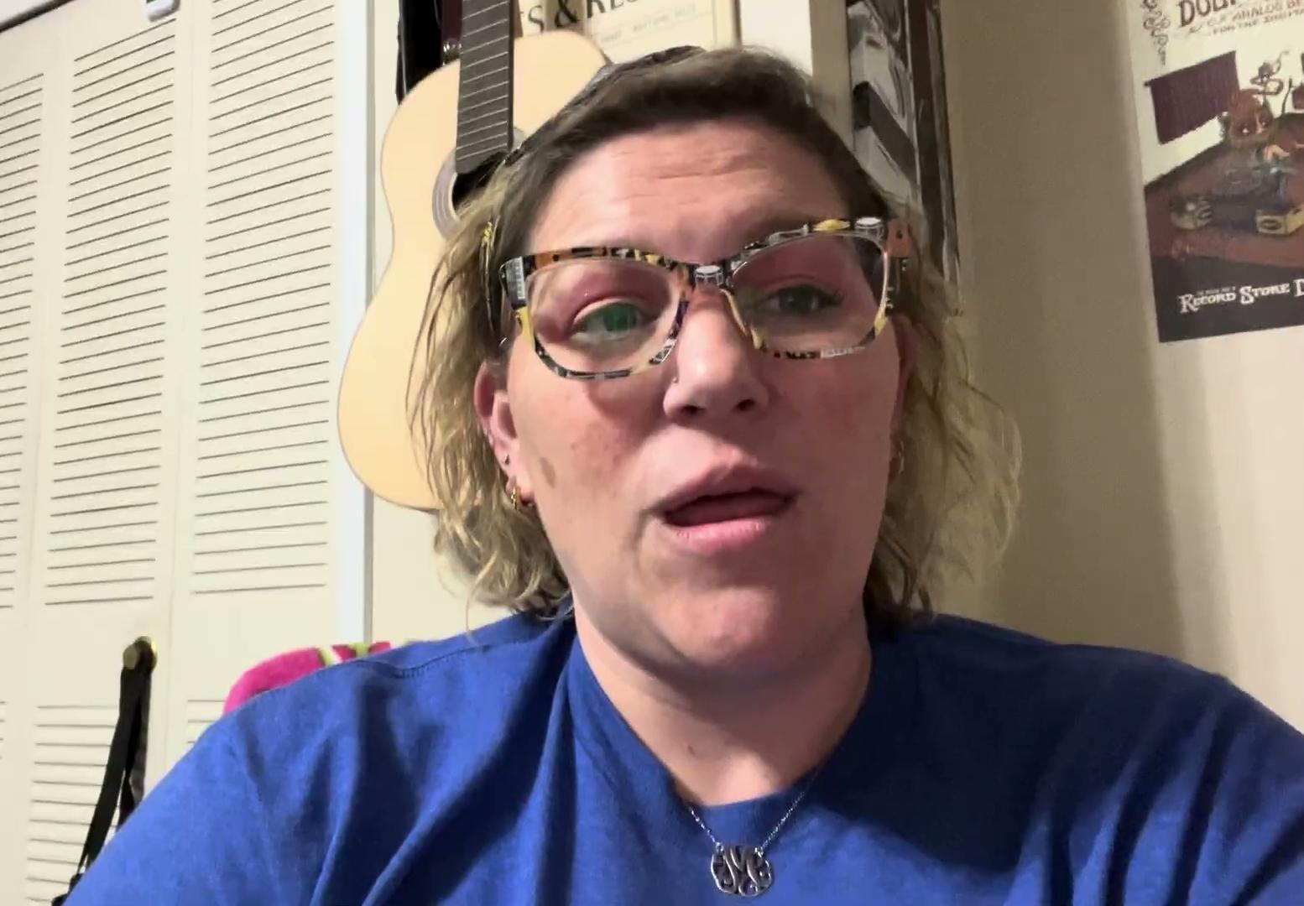
What will happen in the Audition?

Slide 11
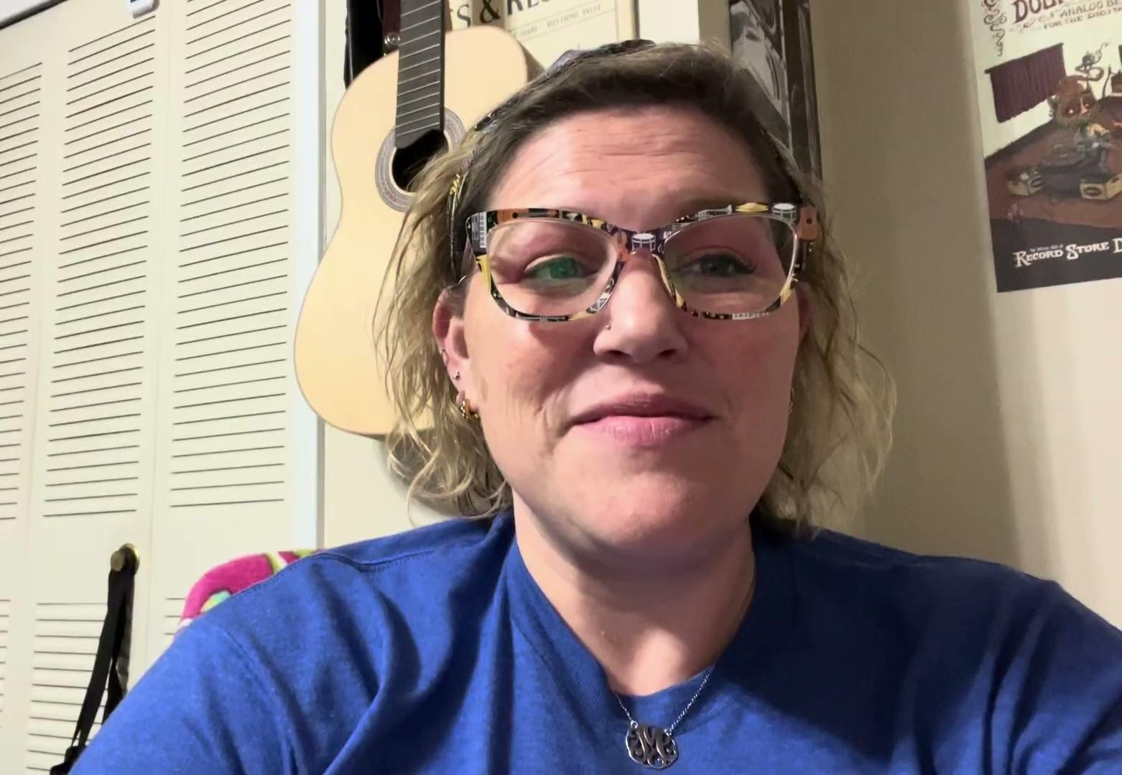
Parents Please Watch

Slide 12
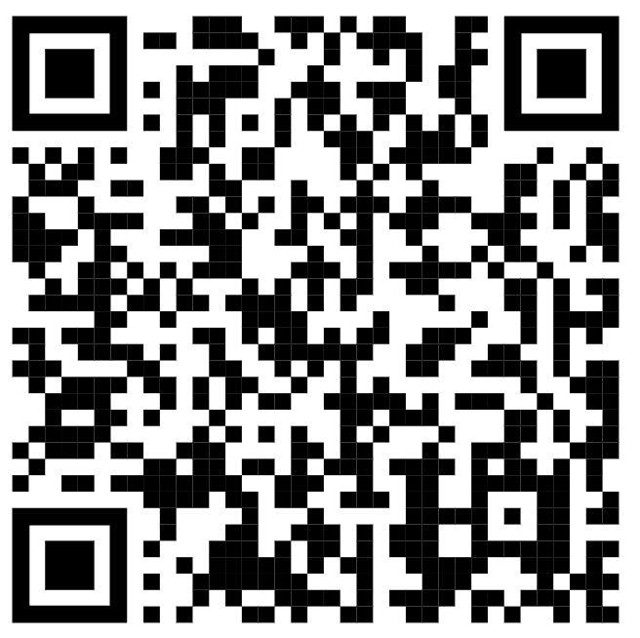
Step 4
Sign up for a group audition time by Monday, December 11th.
https://signup.com/go/OCwTYUG

Slide 13
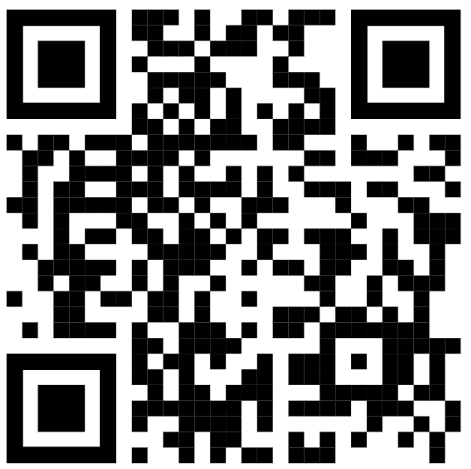
Step 5
Complete the Google Audition Form ONLINE and
upload a full face, head, and shoulders photo of your student,
NO later than Monday, December 9th.
**No LATE signups will be accepted. **
Google Form Sign Up: https://forms.gle/EEkceqvkEwXzS8N19

Slide 14
Remember practice makes
Permeant, NOT Perfect!

